Slide 1

Cougar Tales – 21 APR 2021
COVID:
Vaccines Free for ALL!
Vaccine Hotline
Events:
Military Child Celebration – April 24
Virtual Music Therapy Group – Mondays, April 26 – June 7
Strong Bonds Couple Luncheon – 25 April
Love and Logic Parenting class – 27 April
240th Change of Command – May 1
Mental Health First Aid Course – May 7
Re-Creation Encore! YouTube Live Music – May 10
Announcements:
**Position Announcement** Base Honor Guard
Joining Community Forces Newsletter
Weekly Wellness
5 Ways to be All In to end child abuse
Wing Survey Reminder
Fight Oar Survive Scholarship
Mindfulness with Ch. Campbell
CBD/Marijuana Information
ANG FY21 Bonus AFSCs
Microsoft Teams Transition June
Alternative Dispute Resolution
Cougar Tales are available on the Wing App under Helpful Resources→Cougar Tales
The Wing App also contains a complete calendar of events and more.
Want to be in Cougar Tales? Contact Staff Sgt. Austin Harvill at austin.harvill.1@us.af.mil
Only events 2 weeks from registration deadline/event start will be advertised.

Slide 2
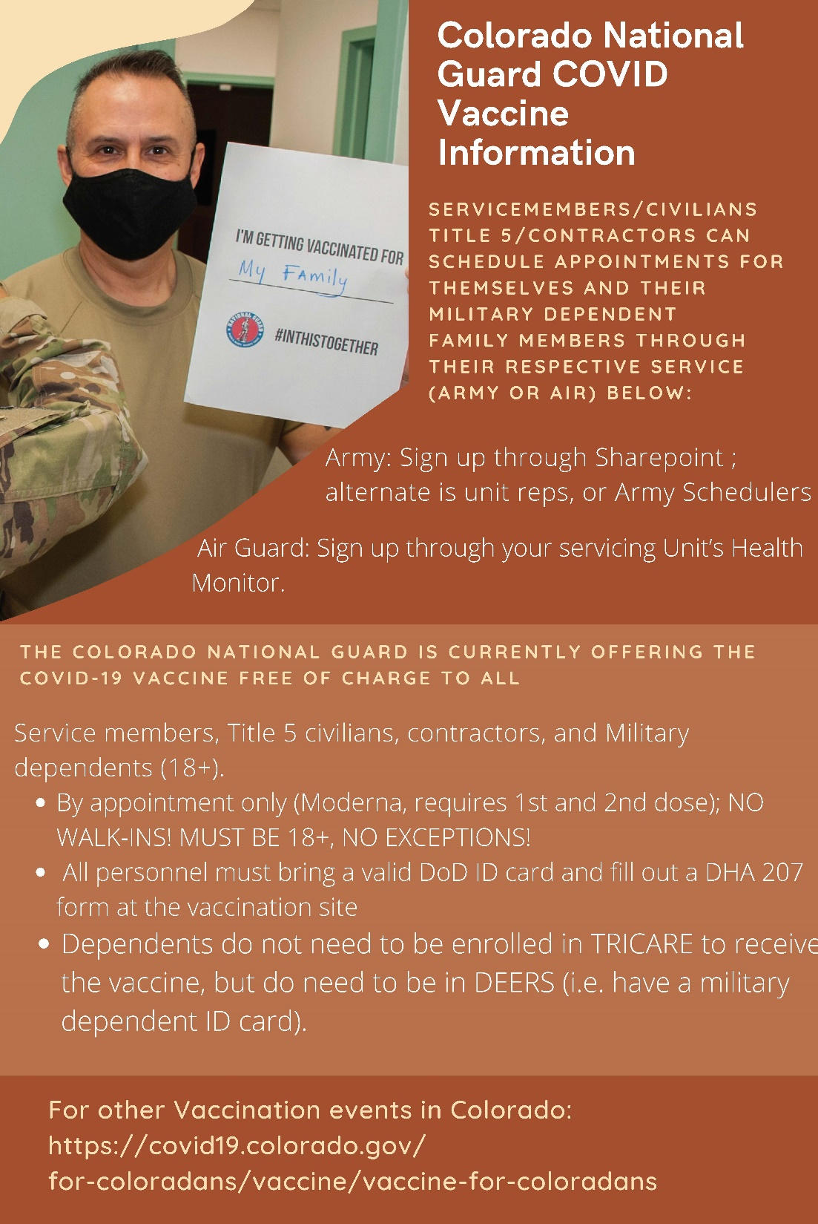
Full pdf: https://control.m360mobile.com/uploads/1021/images/thumb/references/pdf/PublicReleaseSocialMediaFlyerforCONGVaccinations25MAR21_1616775588.pdf
Back to Top

Slide 3

The Colorado Department of Public Health and Environment launched a new call center for the public to ask questions specifically about the COVID-19 vaccine. Beginning Feb. 1, hours will extend to 24 hours a day, seven days a week. The new toll-free number is 1-877-CO VAX CO (1-877-268-2926).
Vaccine call center staff are trained to answer COVID-19 vaccine-related questions, provide information about vaccine providers across the state, and give general information about COVID-19. Fifty operators are available to answer calls and can provide information in multiple languages. Staffing will expand as call volume requires.
The 1-877-CO VAX CO number is the go-to for vaccine-related questions for the general public, but they should continue using the Colorado Health Emergency Line for the Public (COHELP) and 2-1-1 Colorado for general information about COVID-19, such as the number of cases in Colorado, the list of symptoms, or how you can protect yourself.
Back to Top

Slide 4
RSVP to:
Lance.k.ellis2.ctr@mail.mil

Slide 5
Registration Link:
https://www.angstrongbonds.org/ems/url/IkSfcpCQtEgDHRHrg2FKjg

Slide 6

Full PDF:
https://control.m360mobile.com/uploads/1021/images/thumb/event/pdf/Sturm_MT_GeneralFlyer.pdf

Slide 7
Love and Logic Parenting class
For Child Abuse Awareness Month, Family Advocacy will be offering a virtual introduction to the Love and Logic Parenting class on 27 April 2021 from 1200-1400. Love and Logic is a model dedicated to making parenting fun and rewarding, instead of stressful and chaotic. The model helps to provide practical tools and techniques that help adults achieve respectful, healthy relationships with their children.
In the 2-hour mini class, we are offering an introduction into the core principles and skills in Love and Logic, where we will explore the benefits and advantages to using these parenting techniques as well as to allow participants to ask questions they may have. The information provided will be a mini snip-it of the full class that Family Advocacy will offer in May. For more information, please call Family Advocacy at 720-847-6453.
Click on this link (or paste in your browser) to sign up: https://teams.microsoft.com/l/meetup-join/19%3ameeting_Y2ZmNGJhOGItMDZhZC00YjM2LTlmOGUtN2NkYWJhOTljZjc5%40thread.v2/0?context=%7b%22Tid%22%3a%2221acfbb3-32be-4715-9025-1e2f015cbbe9%22%2c%22Oid%22%3a%22dd8d52ed-ae2b-4444-ad92-e541b7b4c236%22%7d
Sandy
SANDRA D. WHITAKER, DAFC
Buckley Garrison Violence Prevention Integrator
510 S Aspen Street, Bldg 1030
Buckley AFB CO 80011
DSN 847-6046 Comm 720-847-6046

Slide 8
240th Change of Command, 1 May
Airmen of the 140th Wing,
Please see the link below for the 240th Civil Engineer Flight’s change of command ceremony and Col Markowitz’s retirement ceremony.
https://einvitations.afit.edu/inv/index.cfm?i=589318&k=07694B0A7A5F
Date: 1 May 2021
Time: 1300
Location: Facebook Live (in-person attendance must be coordinated with event POC)
www.facebook.com/140WG/

Slide 9

Full PDF:
https://control.m360mobile.com/uploads/1021/images/thumb/event/pdf/Colorado_Elks_(1).pdf

Slide 10

Full pdf: https://control.m360mobile.com/uploads/1021/images/thumb/event/pdf/MHFAxBuckley.pdf
Back to Top

Slide 11
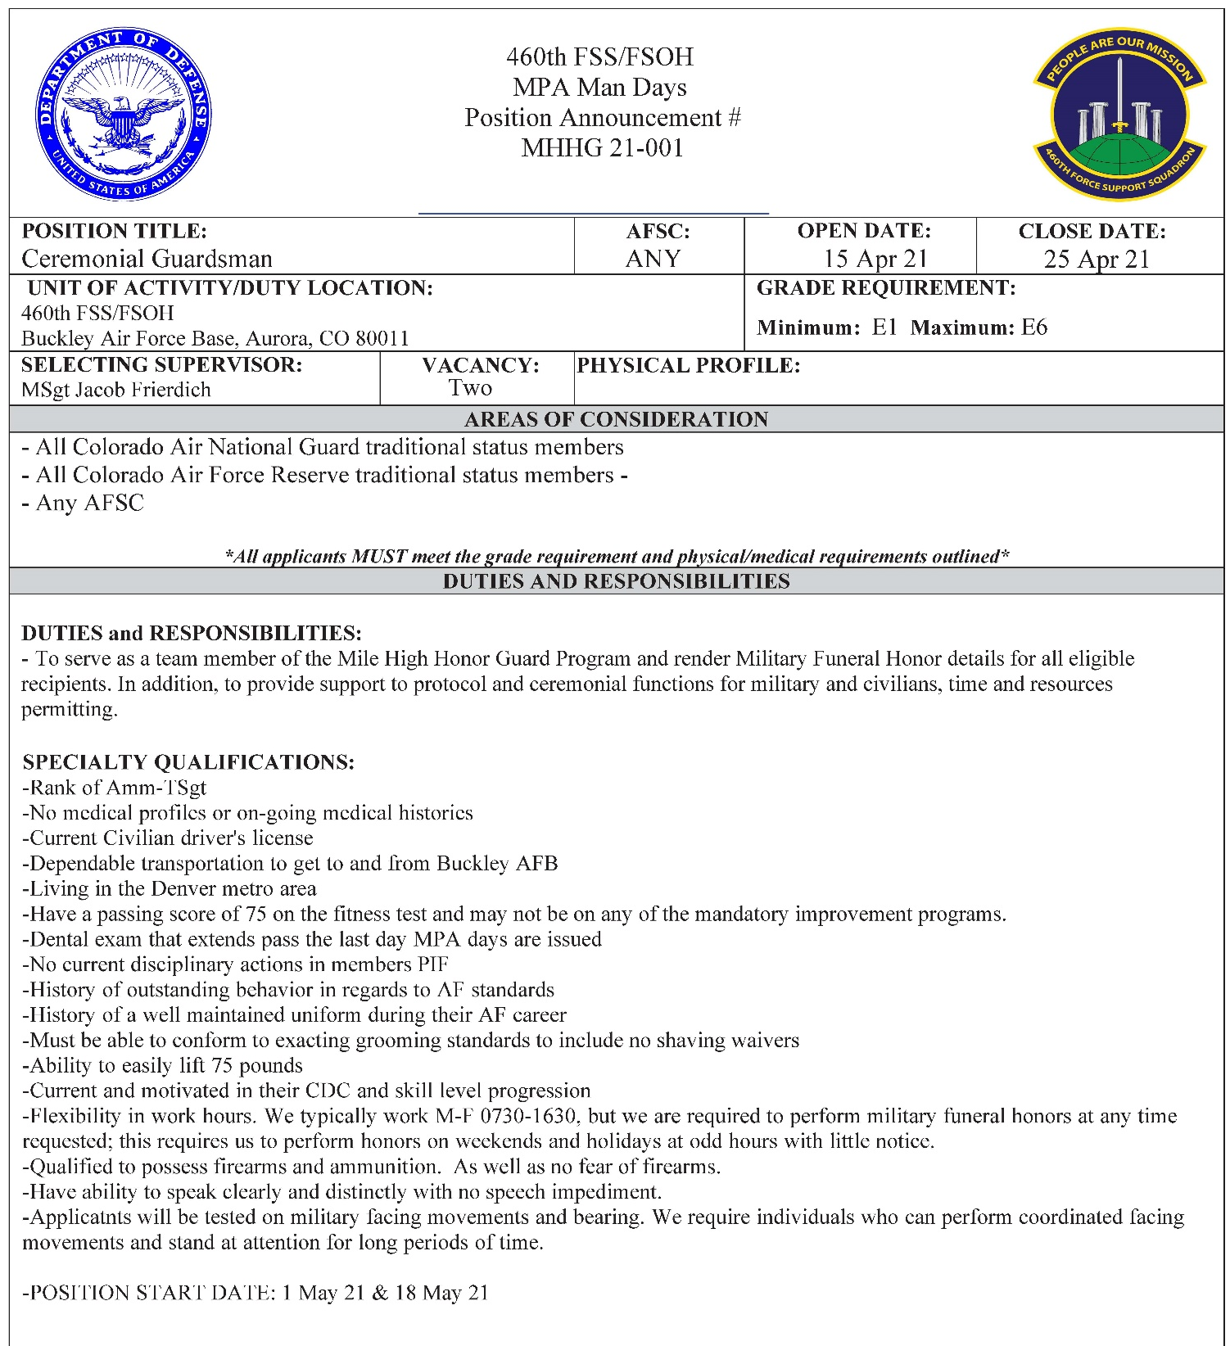

Slide 12
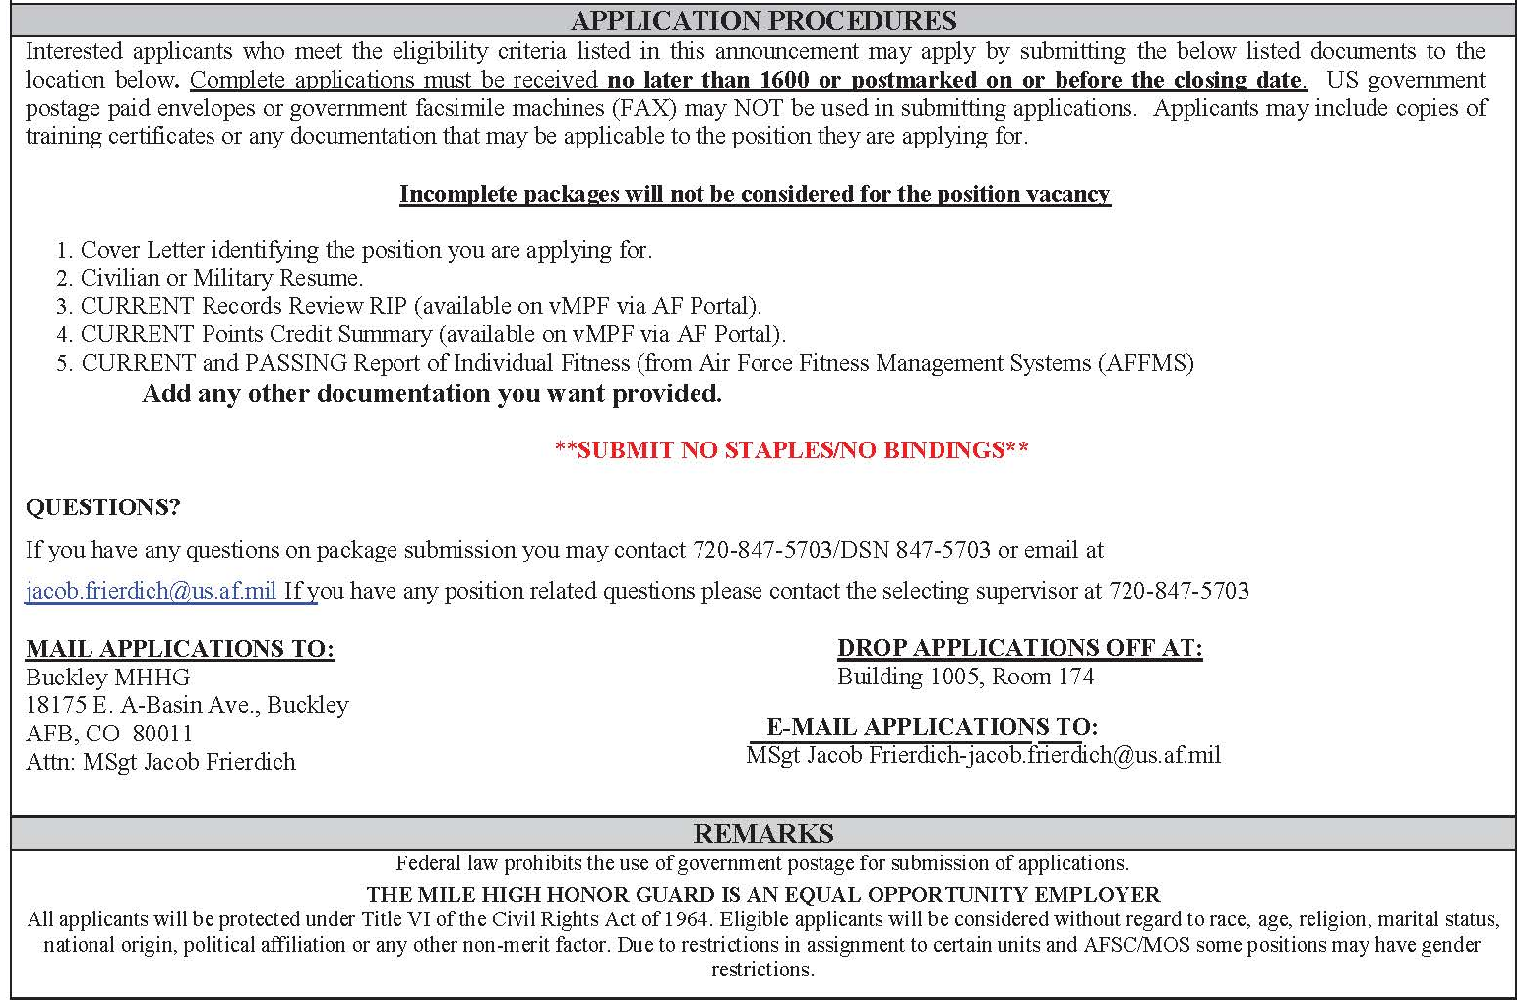

Slide 13
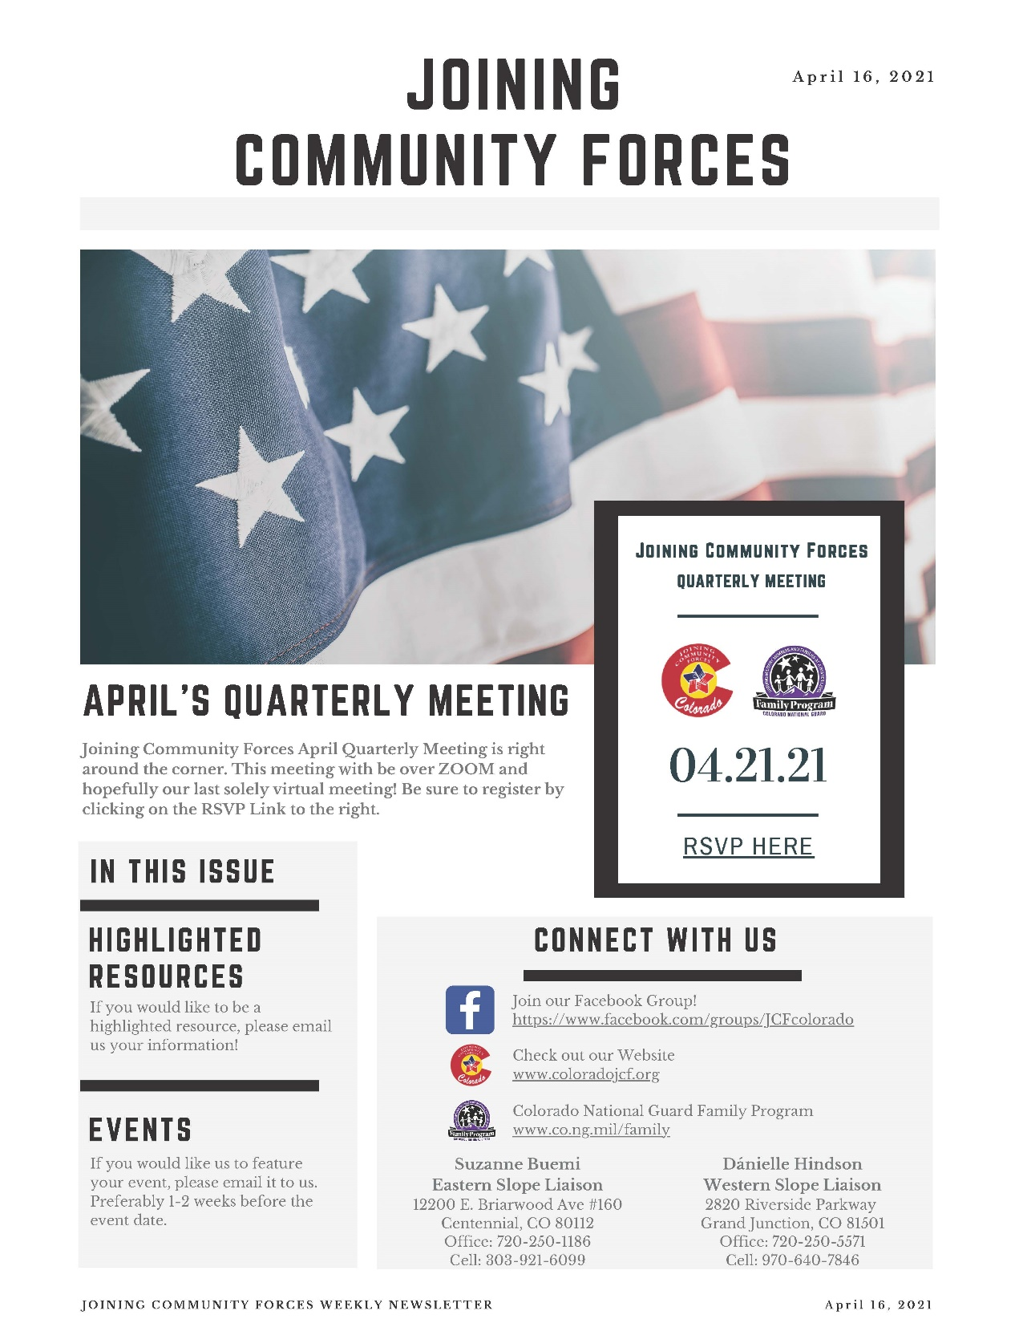
Joining Community Forces Newsletter is a weekly publication advertising activities and opportunities in the local area.
Full PDF:
https://control.m360mobile.com/uploads/1021/images/thumb/references/pdf/JCFNewsletter41621_1619033429.pdf

Slide 14

Full PDF: https://control.m360mobile.com/uploads/1021/images/thumb/references/pdf/April2021HPWWNutrition_1619036271.pdf

Slide 15


Slide 16

Full pdf: https://download.militaryonesource.mil/12038/FAP/MCFP-CAPM2021-Flyer.pdf

Slide 17

Climate Surveys were e-mailed to all relevant members

Slide 18
Fight Oar Survive Scholarship
Point of contact is Laurie Knight (admin@usvetrow.com)
Link: https://www.usvetrow.org/scholarships.html
Who Is Eligible?
1. Military or Veteran, OR immediate family member of such (spouse/partner, child, parent, grandparent, etc.) who is in a program studying to work in mental health for Veterans/military and is at least pursuing the Masters level of education and has been touched by suicide.
The student must be enrolled in CACREP or APA accredited university or college.
In order to qualify for scholarship candidacy, please provide the following:
•DD214 or military/dependent identification (no social security numbers please).
•500 word essay explaining why Veteran mental health and suicide prevention is important. Please include how YOU were touched by suicide.
•Endorsement OR letter of recommendation with verified enrollment and good standing from university/college officials.
If awarded, a report on how the funds were spent will be required.
________________________________________
2. Psy.D. student of the University of Denver who plans to work with Veterans post-graduation.
In order to qualify for this scholarship, students must provide the following:
•500 word essay explaining why Veteran mental health and suicide prevention is important. Please include why you went into this field.
•Endorsement OR letter of recommendation with verified enrollment and good standing from university/college officials.
•Letter of explanation detailing intended plans for working with Veterans post-graduation.
If selected for this scholarship, you will be asked to provide detailed documentation on how the money was spent.
________________________________________
3. Student enrolled in a CACREP or APA accredited university or college who is involved in research in the Veteran mental health field as it pertains to Suicide Prevention. In order to qualify for scholarship candidacy, please provide the following:
•500 word essay explaining why Veteran mental health and suicide prevention is important.
•Endorsement OR letter of recommendation verifying enrollment and good standing from university/college officials.
•Letter of explanation or abstract detailing the research the institution is doing and the student’s involvement in said research.
If awarded, a report on how the funds were spent will be required.
Sincerely,
Suzanne Buemi
Colorado National Guard
Interim State Family Program Director
12200 E. Briarwood Avenue, Ste. 160
Centennial, Colorado 80112
P: (720) 250-1186
C: (303) 921-6099
Email: Suzanne.m.buemi.civ@mail.mil

Slide 19

Training Your Mind to Thrive with Chaplain Brett Campbell
Our thoughts have great power over how we live our lives. Whether we are aware of our thoughts or not, they are continuously telling us what to do, say and think. This can lead us to doing and saying things that make our lives and the lives of those around us harder than they need to be. While we can't stop our thoughts, we can gain control over how we respond to them by exercising our minds. Mind Training is a set of exercises that can give us that control by teaching us to become more focused and aware of our thoughts and then shifting our thought patterns to align more with our values. Join Chaplain Campbell every Monday, Wednesday and Friday from 11 a.m. - 11:30 a.m. on Zoom as he teaches Mind Training exercises and how they can benefit you in your daily life.
Join Zoom Meeting
https://us02web.zoom.us/j/9039126066?pwd=YW84ZVJiZmdReTlJMTA3Q21rS1NMdz09
Meeting ID: 903 912 6066
Passcode: v4gP42
Back to Top

Slide 20


140 WG WDDRPM: Braxton Olson
Ph: 605-480-3168
233 SG WDDRPM: Rey Ramos
Ph: 719-985-0993
Some useful and potential career saving information regarding marijuana and/or marijuana extracts:
Per AFMAN 44-197, para 1.2.2. “Although some state and local laws have legalized the recreational use of marijuana or marijuana extracts, the drugs remain Schedule I substances under 21 USC § 801 et seq., Controlled Substances Act, and their use by military members is prohibited. Exception: Service members are permitted to use prescription cannabinoid formulations, such as dronabinol (brand names Marinol® and Syndros®) and Epidiolex®, when the medication has been approved by the United States Food and Drug Administration and the Service member has a valid prescription for the medication. Failure by military members to obey the mandatory provisions of this paragraph is a violation of Article 92, UCMJ. Violations of this paragraph may result in disciplinary action under the punitive articles of the UCMJ (e.g., Article 112a, UCMJ). Violations may also result in adverse administration action; criminal prosecution under federal or state laws; or, for ANG members, adverse action under the state military code.”
Know what you’re putting into your body:
The Controlled Substances Act places drugs regulated under federal law in one of five schedules based upon an eight-factor analysis. Marijuana and its extracts, including CBD, are Schedule I controlled substances. Although it is true that section 12619 of the Farm Bill removes hemp-derived products from its Schedule I status under the Controlled Substance Act, legislation does not legalize CBD generally and CBD derived from marijuana therefore remains a Schedule I substance under federal law. The Farm Bill creates exceptions to the Schedule I status in certain situations. The Farm Bill ensures that any cannabinoid that is derived from hemp will be legal, if and only if that hemp is produced in a manner consistent with the Farm Bill, associated federal regulations, associated state regulations, and by a licensed grower. All other cannabinoids, produced in any other setting, remain a Schedule I substance under federal law and are thus illegal.
BOTTOM LINE: Marijuana and marijuana extracts are NOT ALLOWED!

Slide 21


Slide 22

MARIJUANA MYTHS
Think you know about marijuana use in the Military?
Find out what’s MYTH and what’s FACT!
MYTH: Recreational marijuana is legal in my state so I can use it without any consequences.
FACT: Military personnel are not allowed to use marijuana regardless of state, district or territorial laws, including for medical use.
Military Service members caught using, possessing, growing or distributing marijuana can be punished under Article 112a of the Uniform Code of Military Justice (UCMJ) or applicable state code.
MYTH: There is no problem with Military Service members eating energy bars and yogurt that contain hemp seeds.
FACT: Any product with hemp in it may put your career in jeopardy.
Hemp is a plant that naturally contains tetrahydrocannabinol (THC), which is the psychoactive ingredient in marijuana. There is no standard regulation for hemp seed products. Read the ingredients on food you eat and check your Service policy to avoid being punished under the UCMJ.
MYTH: It’s fine to use cannabidiol (CBD) oil because I can buy it legally at the store or online.
FACT: Military Service members can be punished under the UCMJ for using any type of CBD.
Although you can buy CBD in many forms such as oils, sprays and gummies, it is illegal for Military Service members to use.
MYTH: E-cigarette liquid infused with CBD is safe to use if it doesn’t contain other ingredients.
FACT: Currently, there is no way to know for sure what you are putting in your body when you use e-cigarettes and/or e-liquids. E-liquids may contain harmful or illegal chemicals that could hurt your health and career.
Vape oils that contain synthetic CBD have caused seizures, unconsciousness, vomiting, racing heart and other negative side effects in Military Service members.
Contact Us: dha.ncr.comm.mbx.prevent-substance-misuse@mail.mil

Slide 23

Air National Guard FY21 Bonus AFSCs
National Enlisted Bonus AFSCs
National Officer Bonus AFSCs
Health Professionals
Highly Critical
1A8X2-Airborne ISR Operator
1Z4X1-Special Reconnaissance
1A9X1-Special Missions Aviator
2A5X1-Airlift Special A/C Maintenance
1B4X1-Cyber Warfare Operations
2A6X4-Aircraft Fuel System
1C5X1-Command & Control
2A6X5-Aircraft Hydraulic Systems
1N2X1-Signal Intelligence Analyst
2A9X2-Bomber/Special Integrated Instrument
1N4X1-Fusion Analyst
2A9X3-Bomber/Special Electronic Warfare
1N8X1-Target Analyst
2W0X1-Munitions Systems
1Z1X0-Pararescue
4C0X1-Mental Health
1Z3X1-Tactical Air Control Party
3P0X1-Security Forces
Critical
1A0X1-In Flight Refueling Specialist
2A3X8-Remote Pilot A/C Maintenance
1A1X1-Flight Engineer
2A7X5-Low Observable A/C Structural
1A3X1-Airborne Mission System Specialist
3D1X3-RF Transmission Systems
1A6X1-Flight Attendant
3D1X7-Cable and Antenna Systems
1C8X3-Radar, Airfield, Weather System
3E0X2-Electrical Power Production
1N1X1-Geospatial Intelligence
3E2X1-Pavements and Construction
1T0X1-Survival,Evasion,Resistance, Escape
3E4X1-Water & Fuels System Maintenance
2A2X2-SOF/PR Integrated Instrument
4A1X1-Medical Material
2A3X5-Adv. Fighter A/C Integrated Avionics
6F0X1-Finance
11B-Bomber Pilot
12M-Mobility Combat System
11F-Fighter Pilot
12S-Special Ops Combat System
11H-Rescue Pilot
13B-Air Battle Manager
11M-Mobility Pilot
13S-Space Operations
11S-Special Operations Pilot
14N-Intelligence
11U-Remotely Piloted Aircraft (RPA)
15W-Weather
12B-Bomber Combat Systems
17S-Cyberwarfare Operations
12F-Fighter Combat Systems
18A-Attack Remotely Piloted Aircraft
12G-Generalist Combat Systems
19Z-Special Warfare
12H-Rescue Combat Systems
21A-Aircraft Maintenance
42B-Physical Therapist
45B-Orthopedic Surgeon
44E-Emergency Medicine Physician
45G-OB/GYN
44M-Internal Medicine Physician
45S-General Surgeon
44Y-Critical Care Medicine
46F-Flight Nurse
45A-Anesthesiologist
Local Bonus AFSCs (Designated Units)
140FW
2A3X3-Tactical Aircraft Maintenance
2F0X1- Fuels
32EX- Civil Engineer
2W1X1- Aircraft Armament Systems
233 SG
2T3X1- Mission Generation Veh. Equip. Maint.
138 SCS
3D0X2- Cyber Systems Operations
Bonus Amounts vary based on type, AFSC, and job qualification status; please contact your Wing Retention Office Manager for full details and any questions
Retention Office Manager: MSgt Edward Rohde; Edward.Rohde.1@us.af.mil; 720-765-7901

Slide 24

CVR Shutting Down
CVR will be decommissioned on 15 June 2021
All users will be responsible for their data migration
Any files not migrated will be lost
AFNet Teams = CHES Teams = O365 Teams; 15 June – just Teams
HQ CCC AF Portal Site
Notes:
MP1: We have been putting out the word of the CVR shut down. The timer is set on the CVR HomePage. I know everyone loves it and doesn’t want it to go away, but it’s gone on 15 June. Everyone using CVR should migrate their data to AFNet Teams or it will be lost. When we say AFNet Teams, we are talking about the same Teams that was introduced to the AFNet by our CHES team which brought many services into the O365 Cloud environment. So for those who are still a little confused because AFNet Teams has had several nicknames like CHES Teams and O365 Teams, on 15 Jun, their will only be just Teams.
MP2: The Air Force has set up a CVR Sunset working group and has been placing all the latest updates in the The HQ CCC Air Force Portal site.

Slide 25
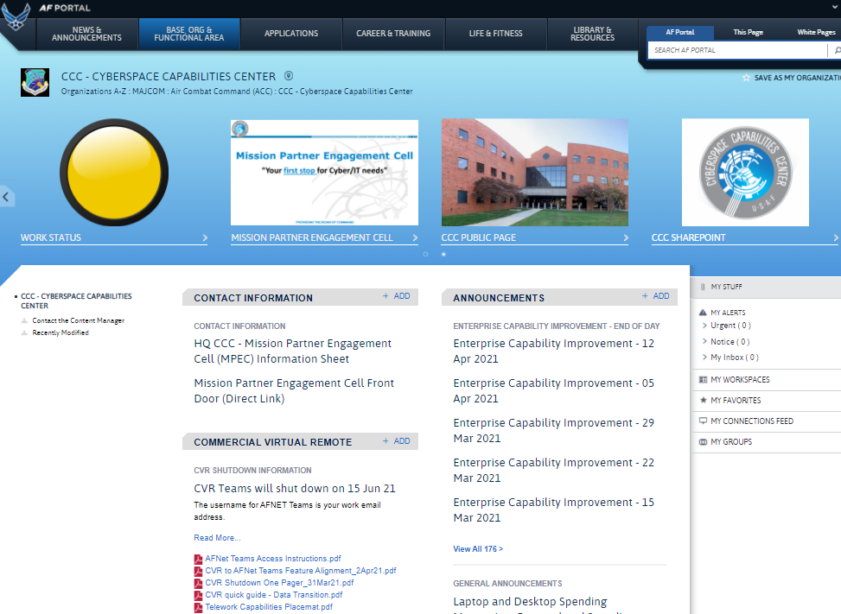
Latest Info – HQ CCC AF Portal Site
HQ CCC AF Portal Site
  AFNet Teams Access Instructions.pdf
  CVR to AFNet Teams Feautre Alignment_2Ap21.pdf
  CVR Shutdown One Pager_31Mar21.pdf
Notes:
MP1: In the HQ CCC AF Portal site, you will find a section with the CVR Shutdown information. This site contain answers to frequently asked questions, a data migration guide, and other important information. This information should be shared with the individual users. The intent of this site is to provide the latest updates and information such as AFNet Teams Access Instructions, CVR to AFNet Teams Feature Alignment and a CVR Shutdown One Pager.

Slide 26
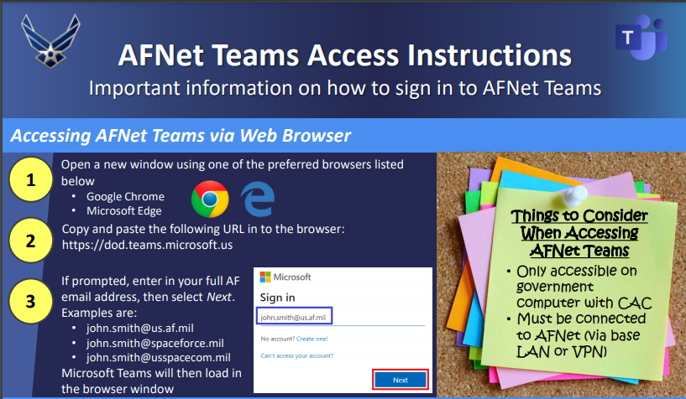
AFNet (CHES)Teams Access Instructions
  AFNet Teams Access Instructions.pdf
Notes:
MP1: The AFNet Teams Access instructions are for those new users who NEVER used it before and need a little help getting set up.
MP2: For accessing through the web, Chrome or Edge is recommended using your 16 digit CAC certificate. Copy and paste the URL and when prompted, enter the full AF email address.

Slide 27
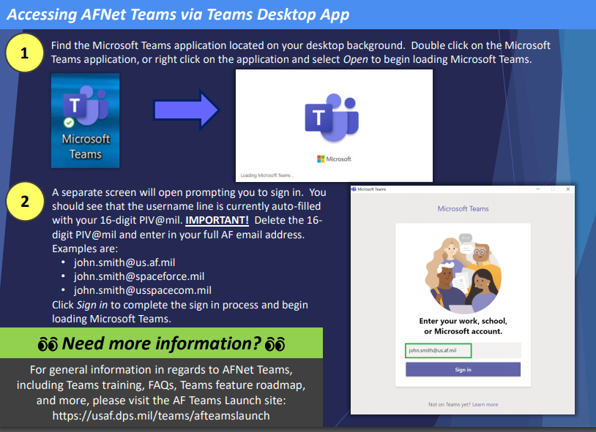
AFNet (CHES) Teams Access Instructions (cont.)
Notes:
MP1: To access through the Desktop, ensure you are completely logged of CVR Teams if that is what you’ve been using.
MP2: Click on the Microsoft Teams icon, delete the old CVR email address or the 16 digit PIV@mil and then enter your full AF email address. That should get you into AFNet Teams.

Slide 28
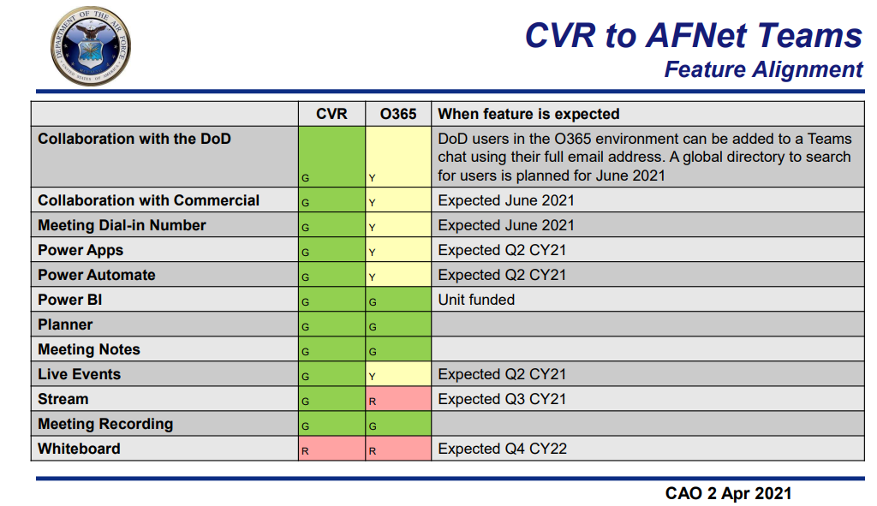
CVR to AFNet Teams
  CVR to AFNet Teams Feautre Alignment_2Ap21.pdf
Notes:
MP1: Another good source of information that is being updated on the CCC AF Portal site is the CVR to AFNet Teams Feature Alignment pdf file. This shows a side by side comparison of CVR to the AFNet or CHES Teams capabilities.
SP1: Green shows capabilities that are current, Yellow have expected completion dates and Red is not till the end of this year or next.
SP2: One of the big questions we have is the Meeting Dial-In Number feature. This is forecasted to be available hopefully before the 15 June Shutdown.

Slide 29
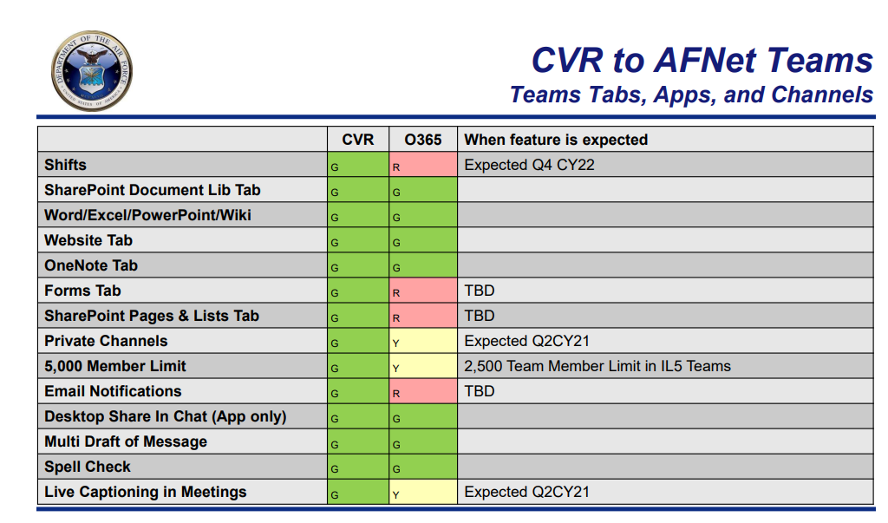
CVR to AFNet Teams (cont.)
Notes:
MP1: Here are more capabilities and timeframe on when they should be available.

Slide 30
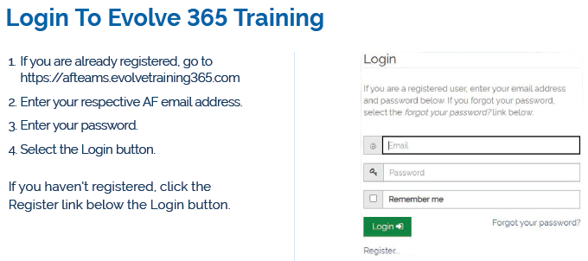
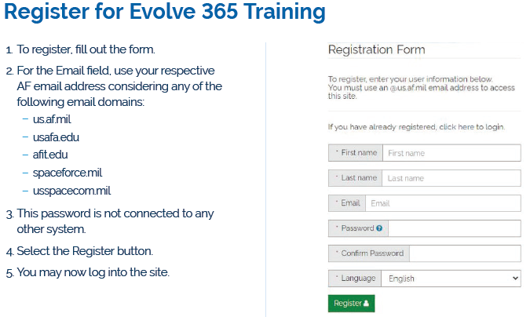
O365 Training Available
Sign up using your @us.af.mil, @spaceforce.mil, @usspacecom.mil, usafa.edu and afit.edu email!
Easily search for training and functionality videos
Some features include Microsoft skill training, videos, webinars and articles
https://afteams.evolvetraining365.com/
Notes:
MP1: Another great feature provided by our O365 team is Evolve 365 training. As long as you sign up with the following email domains, you’ll be able to take advantage of Microsoft Skill training, videos, webinars and articles. This is a great source for NEW AFNet Teams users as this provides training on Teams capabilities.

Slide 31


Slide 32
